Slide 1


CAPSTONE PROJECT
HCMUTE
FACULTY FOR HIGH QUALITY TRAINING
BUILDING A WEBSITE FOR ACCOMODATION BOOKING
Instructor: Dr. Nguyen Thien Bao

Slide 2

Our Group:
Khúc Nguyễn Huy Cường 19110107
Đặng Ngọc Trường Giang 19110104
Nguyễn Đan Trường 19110064

Slide 3

Table of contents
01
Introduction
04
Implementation
Requirements
02
System design
03
Demo
05
Conclusion
06

Slide 4

01
Introduction

Slide 5

Reasons
Online platforms have become more popular as a result of how technology has changed conventional booking procedures. Online booking platforms have revolutionized travel by providing a broad range of accommodation options, real-time availability, and access to user reviews. This digital solution simplifies the booking process, increases choice and convenience, and enhances the travel experience by allowing informed decision-making. The platforms cater to global travelers' needs efficiently due to advancements in technology. The process of implementing such a platform involves several steps, including idea generation, status survey, requirements definition, system and interface design, program installation, testing, and completion.

Slide 6


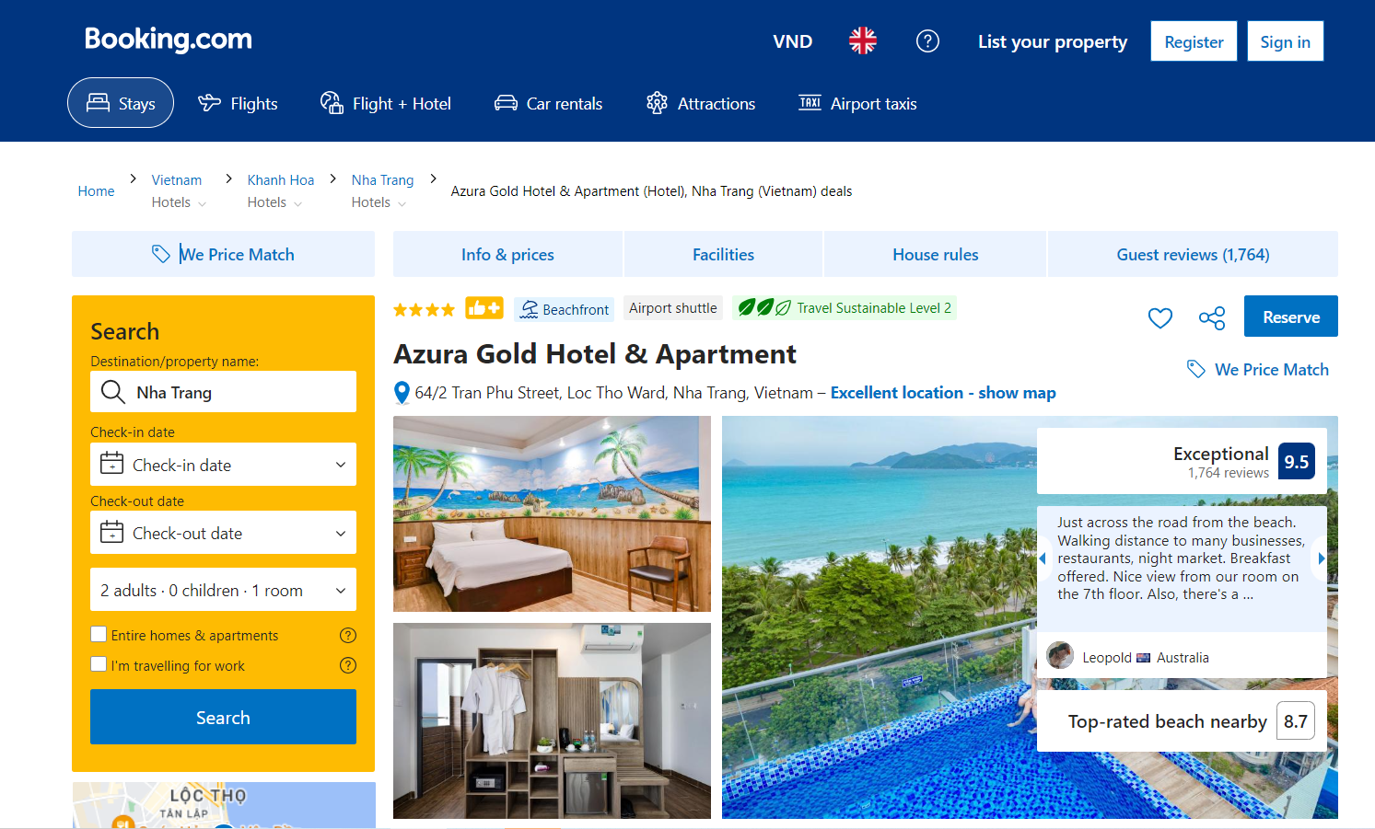
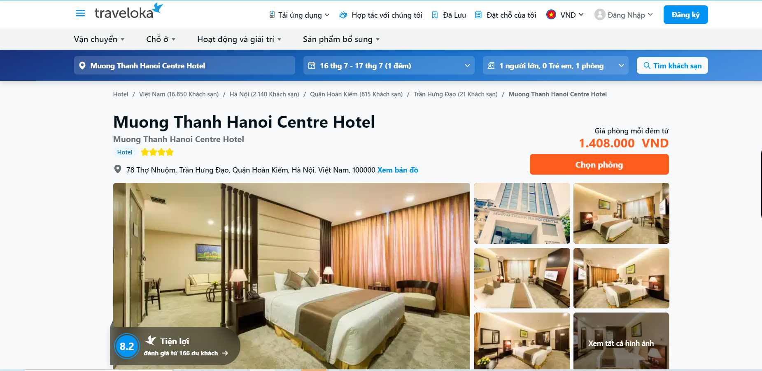
Similar function : booking , rating, comment, Search
Traveloka.com
Booking.com
Weakness
Too much information is displayed
No management page for booking
Weakness
Too much information is displayed
The user interface is quite simple
Interface is not friendly for user interaction

Slide 7
02
Requirements

Slide 8


Functional Requirements
User Experience:
Enhanced interfaces and search functionality.
Advanced filtering options.
High-quality visuals and descriptions.
Features:
Real-time availability and secure transactions.
Extra services like travel packages and car rentals.
Membership benefits.
Mobile Accessibility:
Focus on mobile users.
Mobile apps or responsive websites.
Location-based features and notifications.
Customer Reviews and Ratings:
Importance of user feedback.
Aggregated reviews and ratings.
Fostering industry transparency.
Industry Trends:
AI integration for personalization.
Direct hotel-platform partnerships.
Rise of eco-friendly accommodations.

Slide 9

03
System design

Slide 10

All function
Payment(VNPay, Paypal)
View Bill
Edit personal
information
View statistic
Rating
Log out
Login
Register
Search
View hotel
Booking
Add comment

Slide 11
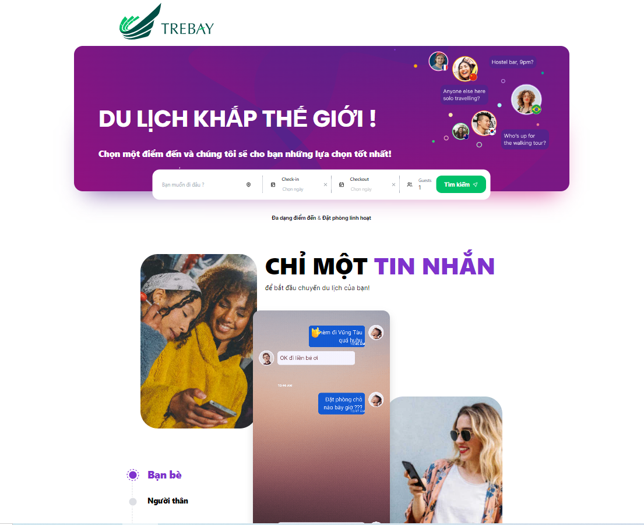
Homepage

Slide 12
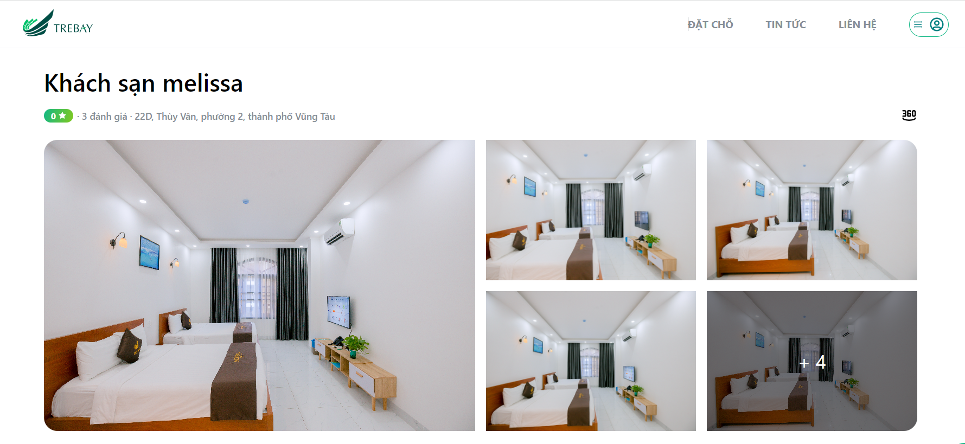
Hotel detail

Slide 13
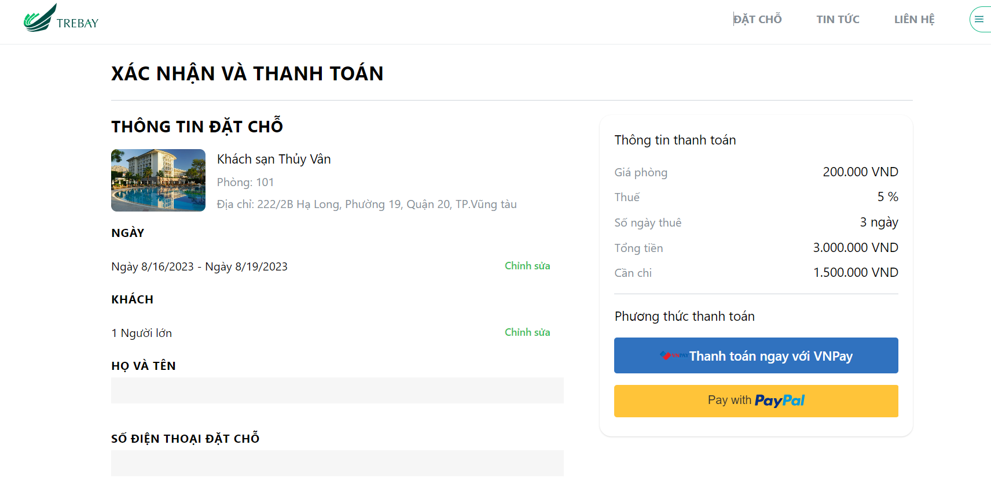
Payment page

Slide 14

04
Implementation

Slide 15


Tools
"
Visual Studio Code.
Postman.
MongoDb compass

Slide 16
Technologies
"
ReactJS.
MongoDB.
Beego.
NodeJS.
Nexjs.

Slide 17

05
Demo

Slide 18
Booking process

Slide 19
Payment process

Slide 20
System management

Slide 21
06
Conclusion

Slide 22
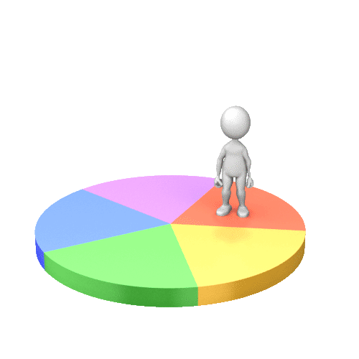
Results
A booking learning website with all function that work well
Including three user types (administrator, accommodation owner, user)
All functions for those types of user (such as: user management, accomodation management, user profile, booking)
Payment gateway diversity (global: Paypal, local: VNPay pay)
Beautiful interface and easy to use
Simple and fast form of payment
User data security

Slide 23

Strength
Drawbacks
The website, designed for easy maintenance, allows quick and efficient updates and development.
A responsive for mobile version of the website enhances user convenience.
The site offers a broad selection of accommodations, efficient booking, real-time availability, competitive prices, and user reviews for better decision-making.
Through effective communication, agile development methodologies, and a detail-oriented approach, the website ensures seamless operation.
The website currently does not provide services for many places
The project experienced delays due to unforeseen technical issues that required additional time and resources to resolve.
We also encountered some communication breakdowns between team members that led to misunderstandings and mistakes.

Slide 24
Future works
• Enhancing the website's search functionality to allow customers to search for hotels by additional criteria, such as: distance to center, bed type deals and discounts, etc.
• Expanding website to allow booking in all over the world.

Slide 25
References
"
TypeScript Quickly. (2020, February 10). Scribd.
Qing, F., Jiao, L., Dai, C., Ziqiang, D., & Zhang, R. (2019). Golang-Based POI Discovery and Recommendation in Real Time.
Li, C., & Yang, W. (2014). The distributed storage strategy research of remote sensing image based on Mongo DB
Liu, S. S., & Mattila, A. S. (2017). Airbnb: Online targeted advertising, sense of power, and consumer decisions. International Journal of Hospitality Management, 60, 33–41.
Tích hợp cổng thanh toán Vn-Pay với ứng dụng của bạn - NTechDevelopers. NTechDevelopers - Programs must be written for people to read, and only incidentally for machines to execute. https://blog.ntechdevelopers.com/tich-hop-cong-thanh-toan-vn-pay-voi-ung-dung-cua-ban/
System Design VN. (2023). Thiết Kế Hệ Thống Airbnb - Viblo. Viblo.
Reduxjs. (n.d.). GitHub - reduxjs/redux-thunk: Thunk middleware for Redux. GitHub

Slide 26
Thank You !

